Slide 1
Session 23
Curriculum Vitae
Preparation and Maintenance

Slide 2
Learning Objectives
Describe and discuss purpose of a curriculum vitae
Identify elements of a curriculum vitae
Prepare basic curriculum vitae
Update and maintain curriculum vitae

Slide 3
Preparation for Court Qualification

Slide 4
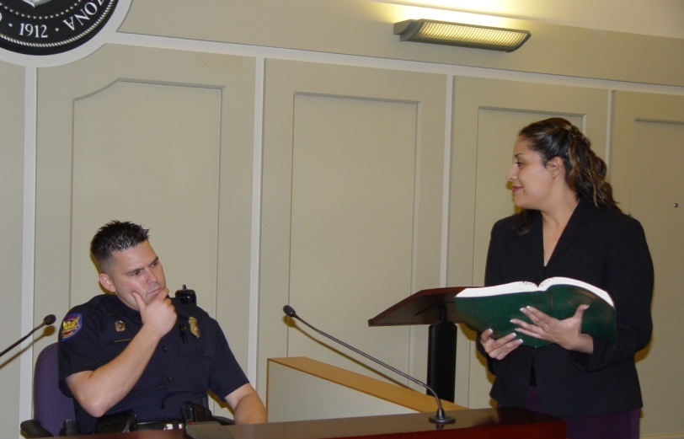
Lay Witness

Slide 5
Tennessee Rules of Evidence 701
If not testifying as an expert, the witness’s testimony is limited to opinions or inferences which are:
Rationally based on the perception of the witness; and
Helpful to a clear understanding of the witness’s testimony or the determination of a fact in issue.

Slide 6
Expert Witness

Slide 7
Tennessee Rules of Evidence 702
If a witness is qualified as an expert:
by knowledge, skill, experience, training, or education …
They may testify in the form of an opinion or otherwise to scientific, technical or other specialized knowledge,
As long as the testimony will substantially assist the trier of fact (Jury) to understand the evidence or to determine a fact in issue

Slide 8
Curriculum Vitae Preparation and Maintenance

Slide 9
The Curriculum Vitae
A Curriculum Vitae is a brief account of your, specialized knowledge, skill, experience, training and education in your area of employment or expertise
(Everything required by Tenn. R. Evid. Rule 702)

Slide 10
Curriculum Vitae Content
Formal Education
Formal Training
Experience
Prior Testimony
Outside Reading Studies
Training or Research Conducted
Published Works

Slide 11
What Should Be In a Law Enforcement Officer’s CV?
Education (only include high school if you did not obtain a college degree)
Experience/Employment(start with your most recent employer and work your way backwards-include arrest log-stats here if you have them)
Specialized Training (include the academy, DUI Detection SFST, ARIDE, DRE, Verbal Judo, and anything relevant to traffic safety, etc.)

Slide 12
What Should Be In a Law Enforcement Officer’s CV?
Every time you qualified as an Expert (Case Names, County, State and Dates)
Instructor Opportunities (List all classes you participated in as an instructor)
List Awards/Recognition for Excellence (You can have this in a separate area, or you can include it in the overall category in which it was received. See example)

Slide 13
Goal of the CV
The goal is to provide sufficient information to qualify you to testify as an expert. Tailor your CV to show your expertise in the area of DUI and drug recognition
Add, change, alter the content of your CV as you gain more specialized training and experience to highlight your area of expertise

Slide 14
What can a well written CV do for you?
It will help you organize your testimony regarding your training and experience
It will educate the jury to your knowledge and expertise
It will raise your credibility with the jury and reinforce the significance of your testimony and opinions

Slide 15
Questions?

